Slide 1
Quality Assurance
COMPANY PROFILE
On time delivery
No inferior goods
STAMPING&METAL PART PROCESSING

Slide 2
COMPANY INFORMATION
Thai Ui Seiken established in 1996 we are a manufacture of electric parts, automotive parts, Assembly parts, Progressive Die ,Single Die and Compound Die. We are affiliated with Hitachi Compressor at Ayutthaya province and other. We moved our factory to Amata City Chonburi Industrial Estate in 2004 and run production mid year. We have produced highest quality products and provide the best service to ensure customer satisfaction.

Slide 3
COMPANY OVERVIEW
Capital : Capital increase Baht 7 Million
Establish : December 1988
Area : 3,320 SQM
Founder & Chairman : MR.TETSUO UI
President : MR.HIDEHIKO FUKUDA
Employees : 80 Persons (include 5 Japanese)
Maximum capacity : 10 million pieces per Month.
Production : Stamping part process mark to progressive and single die and assembly parts
Certification : ISO9001, IATF16949, GREEN INDUSTY II (GI II)

Slide 4
KEY PEOPLE
PRESIDENT
MARKETING MANAGER
MR. HIDEHIKO FUKUDA
MS. PATCHARA ROSCHUN
FOUNDER & CHAIRMAN
MR. TETSUO UI
MANAGING DIRECTORS
MR.HISAO YAMAGUCHI

Slide 5
AWARD
2007Y
2010Y
2012Y
2014Y
2015Y
2015Y
2016Y
2017Y
2018Y
Our award, speaks for our quality

Slide 6
AWARD
2019Y
2020Y
2022Y
2023Y
Our award, speaks for our quality

Slide 7
MAIN CUSTOMER
AUTOMOTIVE PART | ELECTRONIC PART
THAI SUMMIT MITSUBA ELECTRIC MANUFACTURING CO., LTD. | GMCC and Welling Appliance Component (Thailand) Co.,Ltd.
SAWAFUJI ELECTRIC (THAILAND) CO., LTD. | DAIKIN COMPRESSOR INDUSTRIES CO., LTD.
YAHATA FASTENER THAI CO., LTD. | SIAM COMPRESSOR INDUSTRY CO., LTD.
MINEBEA ACCESSOLUTIONS THAI LTD. | DAIKIN TRADING (THAILAND) CO., LTD.
CENTRAL PRECISION PART CO.,LTD. | TCFG COMPRESSOR (THAILAND) CO.,LTD.
 | THERMODISE (THAILAND) LIMITED.
 | HITACHI-JOHNSON CONTROL AIR CONDITIONING INC
 | TENMA (THAILAND) CO., LTD.

Slide 8
Automotive part
16%
KEY PRODUCTS
Automotive part
Electronic part
Electronic part
84%

Slide 9
DCI
33%
MARKET ANALYSIS
SCI
44%
GAT
6%
TSM
6%
CPP
0.5%
Tenma
2%
Sawafuji
3%

Slide 10
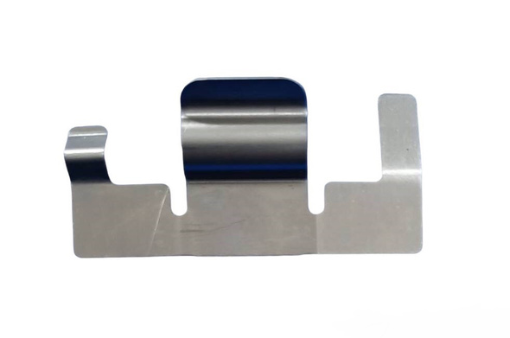
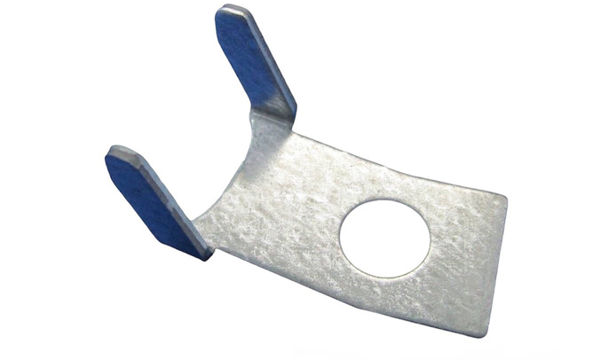
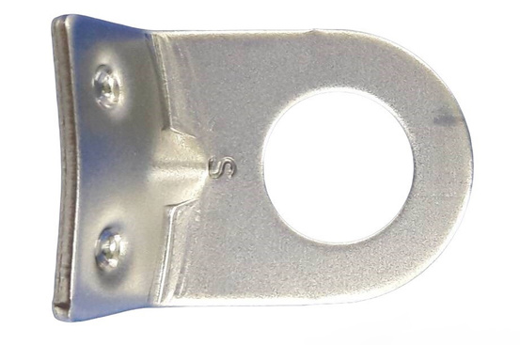
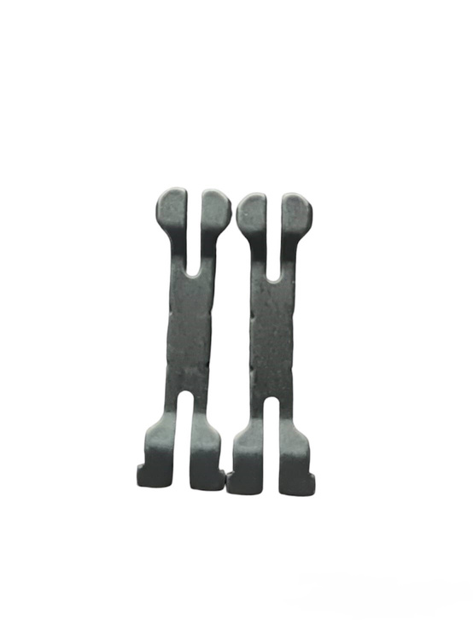
PRODUCT

Slide 11
PRODUCT

Slide 12
OUR SUPPLIER

Slide 13
OUR MACHINE

Slide 14
OUR MACHINE

Slide 15
MACHINE SHOP
CNC Milling
Wire cut
Milling Machine
Aero Lap
Progressive Die
Grinding Maching
Lathe Maching
Mold desing

Slide 16
MEASURING EQUIPMENTS
Image dimension measurement
Imcroscope
Non contact
Profile projector
Contour & Roughness

Slide 17
CONTACT
Thai ui seiken Co.,Ltd
700/195Amatacity Chonburi Industrial Estate Moo 1 Tambol Bankao Amphur Panthong Chonburi 20160
Tel.(66) 0-3846-8431-39
Fax.(66) 0-3846-8440
www.thaiuiseiken.com
MR. HIDEHIKO FUKUDA, President :Ext. 111
MS. PATCHARA ROSCHUN Makting MGR
SALE : Ext. 102,123
QA/QC : Ext. 117,120
Engineer: Ext. 111
Accountion : Ext. 108
Purchasing: Ext. 103,104,107

Slide 18
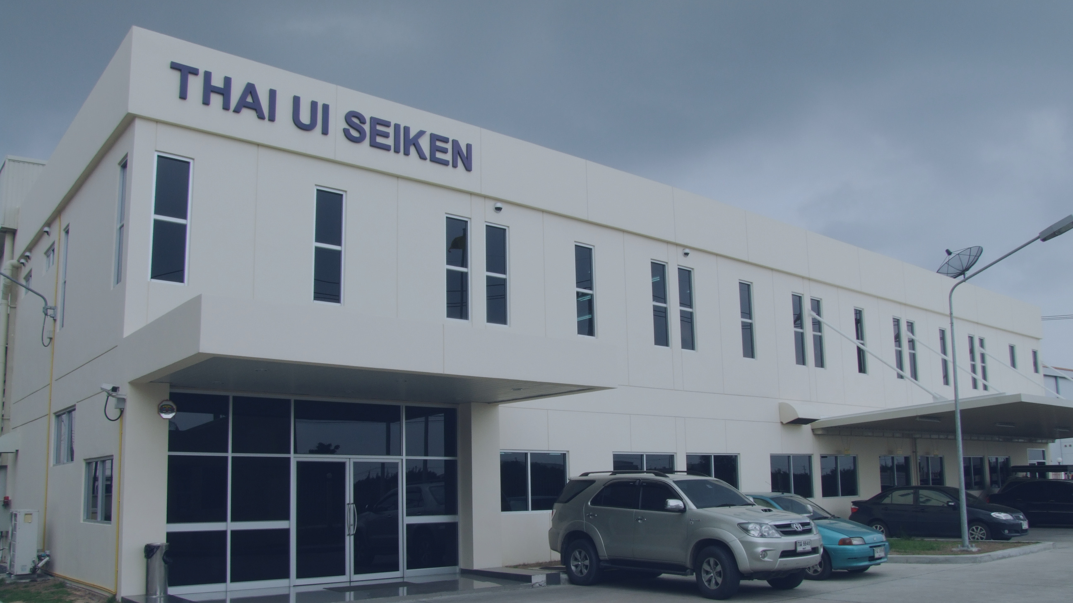
OFFICE
Thai ui seiken Co.,Ltd
700/195Amatacity Chonburi Industrial Estate Moo 1 Tambol Bankao Amphur Panthong Chonburi 20160
Tel.(66) 0-3846-8431-39
Fax.(66) 0-3846-8440
THANK YOU
www.thaiuiseiken.com
We look forward to working with you.

